Slide 1
Loops
The While Statement
Counting Loops
Nesting Loops and Ifs
Infinite Loops
Sentinel Controlled Loops
Result Controlled Loops
Random

Slide 2
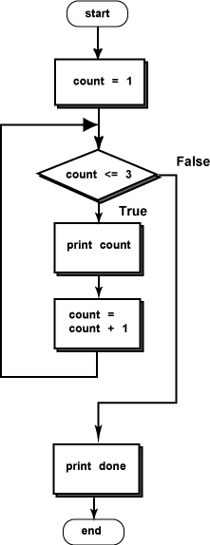
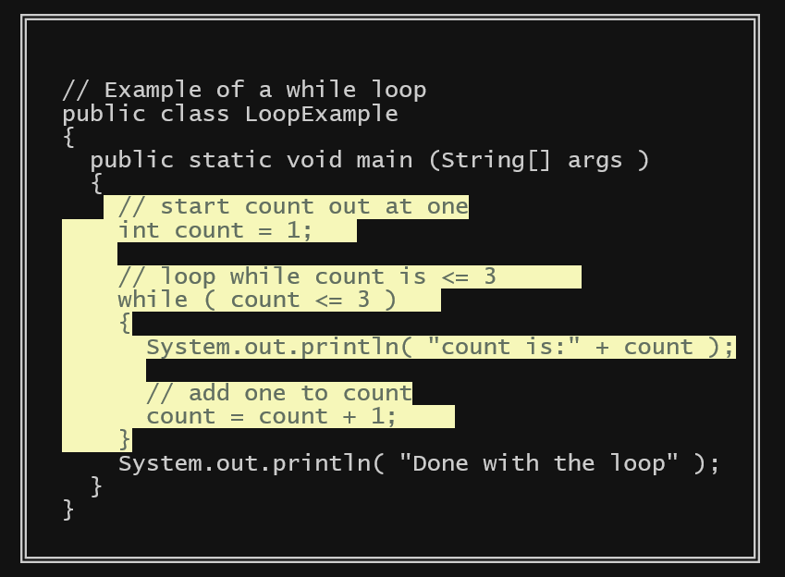
The While Loop

Slide 3
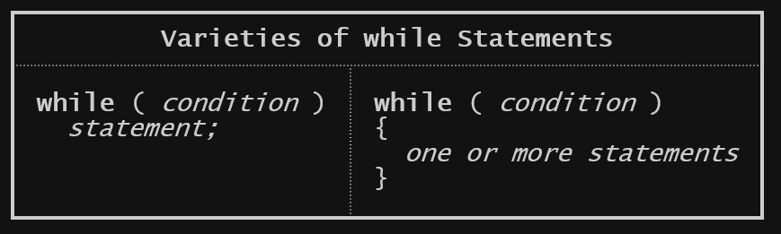
Syntax of the while statement

Slide 4
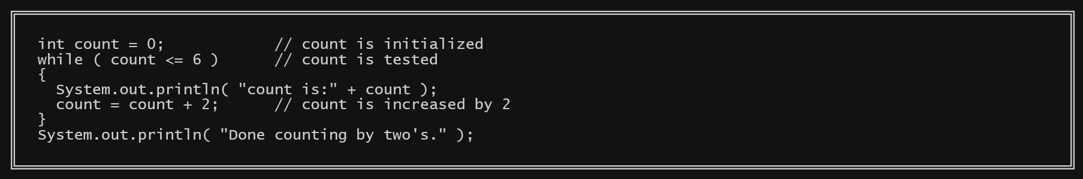
Counting Upwards by Two's
What happens?

Slide 5
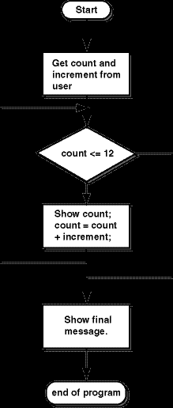
Iteration
Each execution of a loop body is called an iteration. Sometimes the general concept of looping is also called iteration.
In a counting loop, each iteration changes an integer loop control variable by an integer amount. The amount of change can be positive or negative.
What is the loop control variable in the flowchart? count

Slide 6
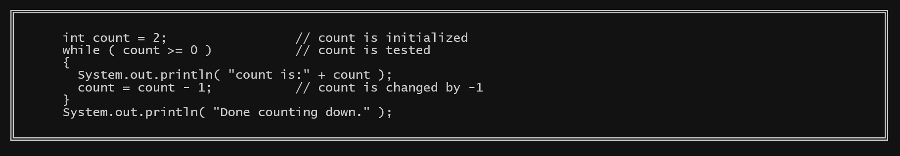
Decrementing the Loop Control Variable
What happens?

Slide 7
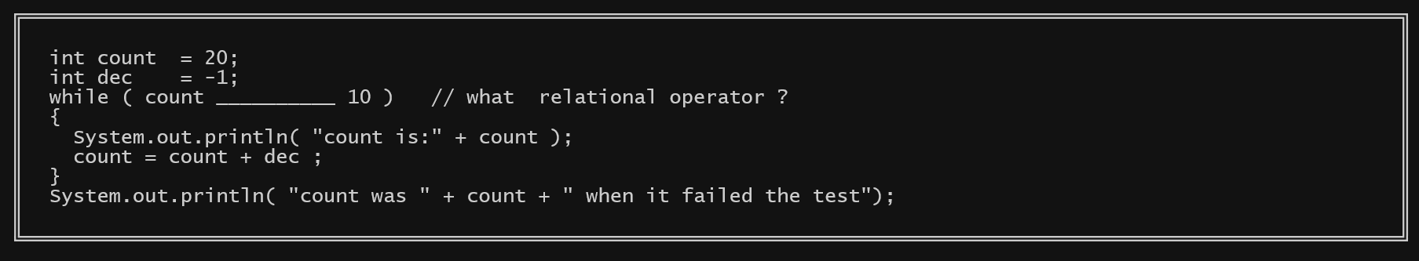
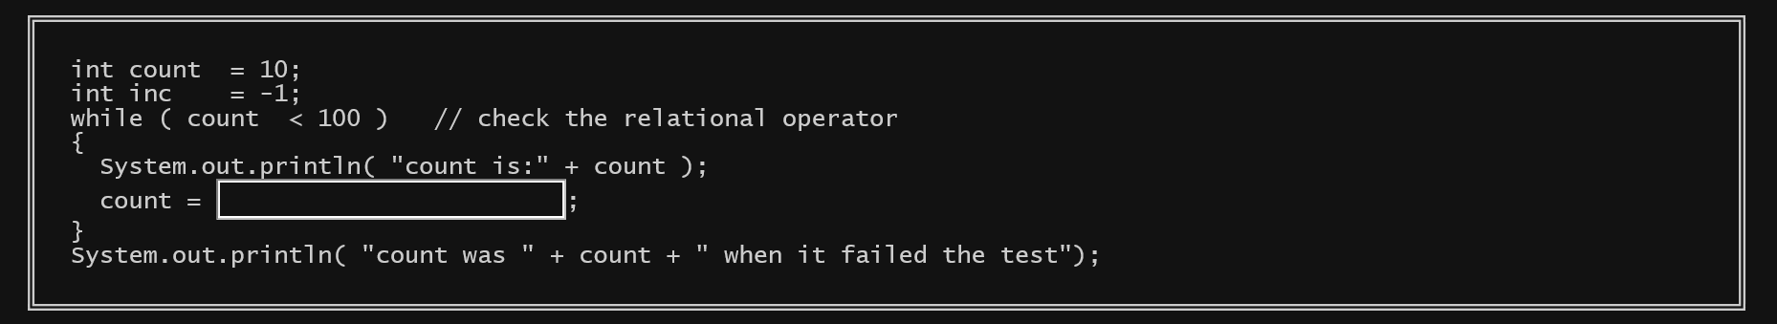
Infinite Loop Can you make either loop infinite?

Slide 8
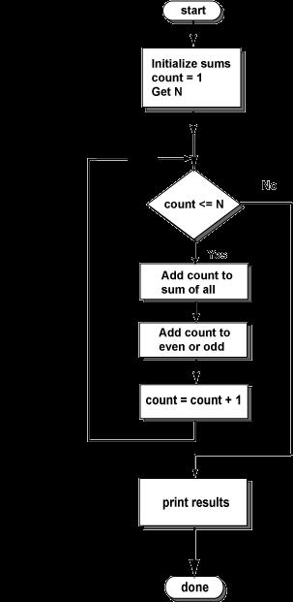
Adding Up Integers
The flowchart shows a loop that increments count from 1 to N.
In the loop body, the current value of count is always added to the sum of all integers.
But more work needs to be done. Count should be added to the sum of odds only if it is odd and added to the sum of evens only if it is even.
This box:
needs more detail.

Slide 9
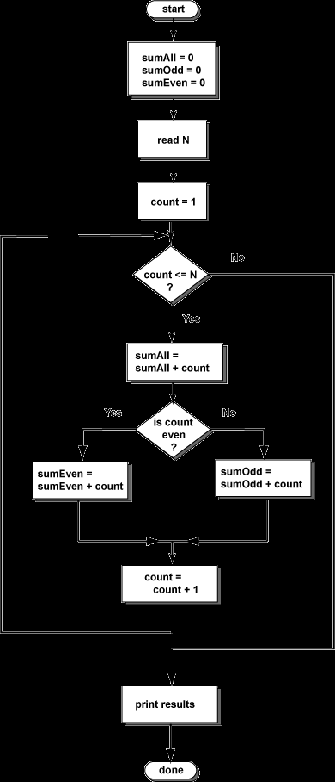
Nested IF
The flowchart is a refinement of the first one. It explicitly shows three sums, and how each sum is handled.
The loop body shows that the current value of count is always added to sumAll.
An if statement determines if count is added to sumEven or sumOdd.

Slide 10
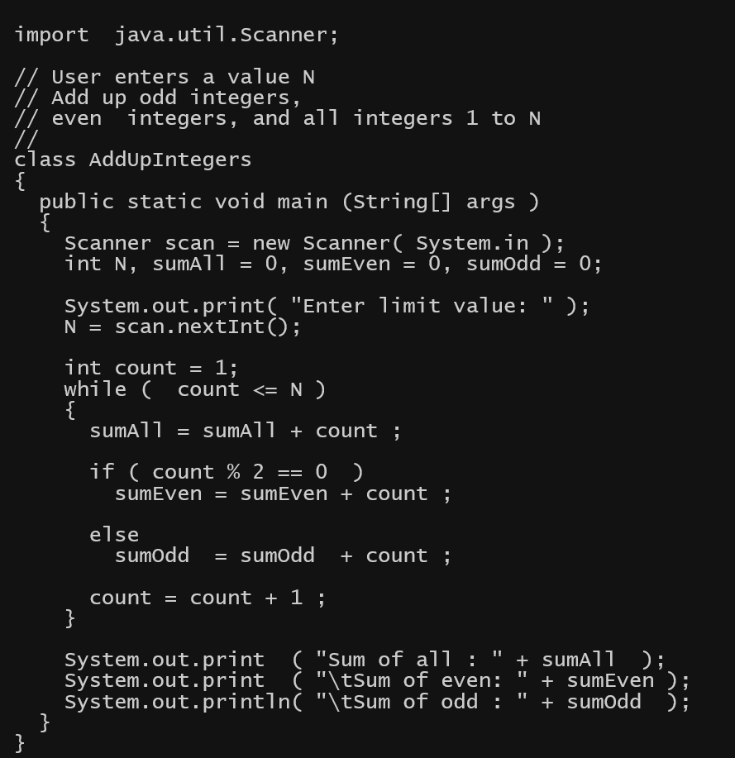
Complete Program

Slide 11
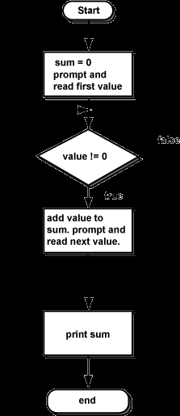
Sentinel Controlled Loops
A sentinel controlled loop uses a special value (the sentinel) to say when the loop is done.
It’s a variable whose value is usually garnered through input from the user
What’s the sentinel in this example? value

Slide 12
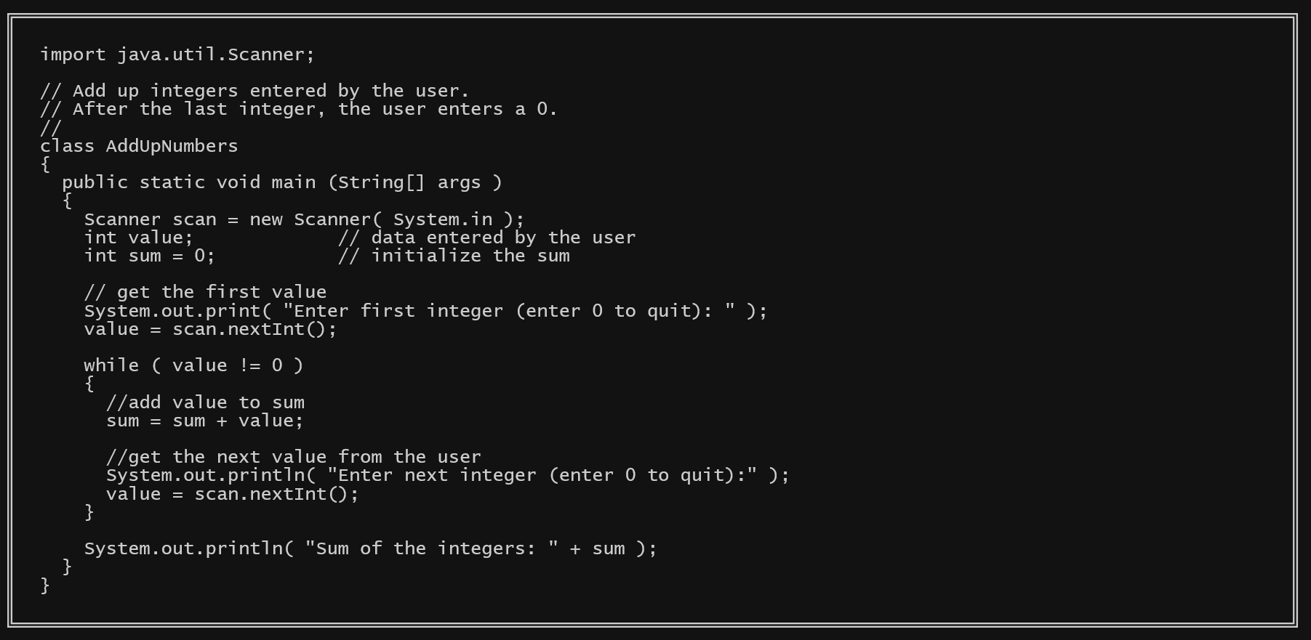
Complete Add Up Program

Slide 13
Result-controlled Loops
A third kind of loop can be built from the fundamental control statements in Java. This is the result-controlled loop. (Other names for it are free loop and general loop).
A result-controlled loop keeps looping until the computation has reached a particular goal, without knowing exactly how long that might take.

Slide 14
Million Dollar Question
Usually banks pay interest daily or monthly, but for simplicity let us stick with interest paid once at the end of each year.
Also, assume that for the following year, interest is paid on the total amount of money in the account (including the interest for the previous year). At the end of the second year you will have $1050 + $1050*0.05 = $1102.50.
What if you are interested in becoming a millionaire? How long will it take to reach one million dollars?

Slide 15
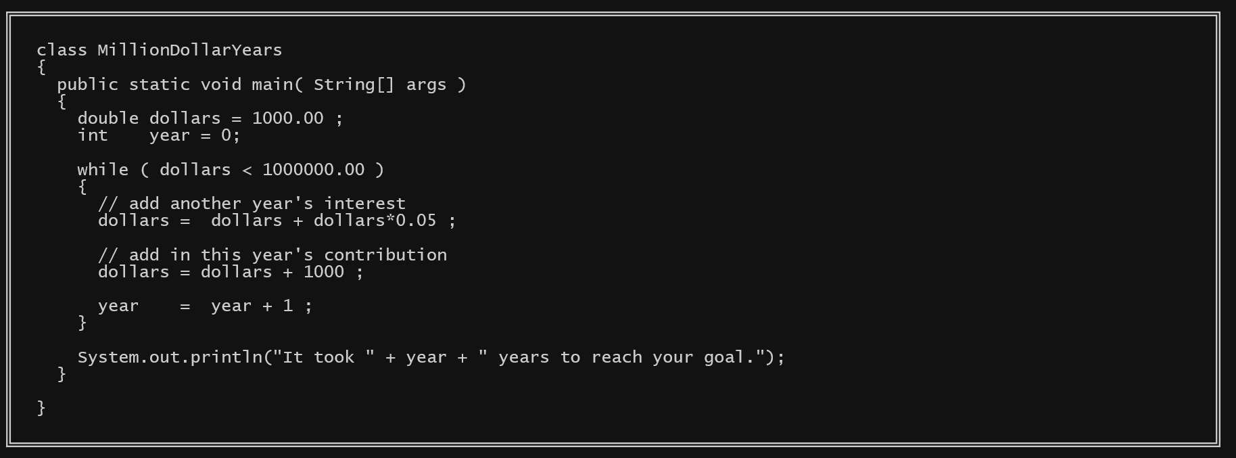
Program

Slide 16
The do…while Loop
The Java programming language also provides a do-while statement, which can be expressed as follows:
do {
statement(s)
} while (expression);
The difference between do-while and while is that do-while evaluates its expression at the bottom of the loop instead of the top. Therefore, the statements within the do block are always executed at least once, as shown in the following
class DoWhileDemo {
public static void main(String[] args){
int count = 1;
do {
System.out.println("Count is: " + count);
count++;
} while (count < 11);
}
}

Slide 17
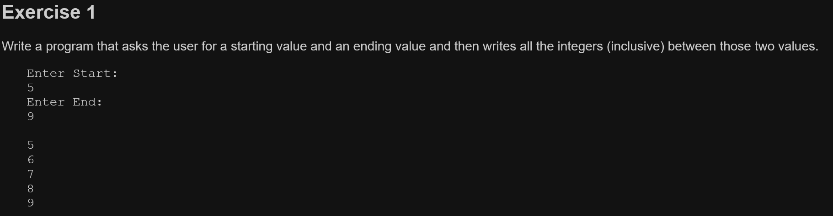
Exercises Create at least one class from each of the 5 parts. Save the project as “prjJavaLoops”. Part 1

Slide 18
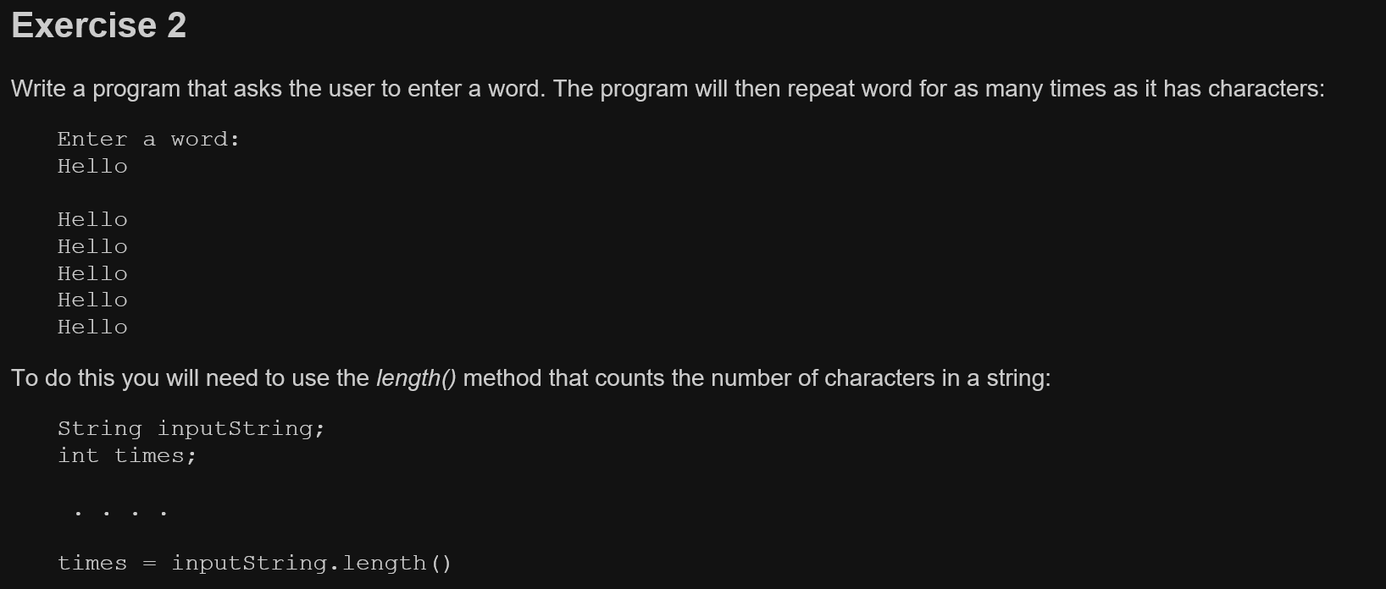

Slide 19
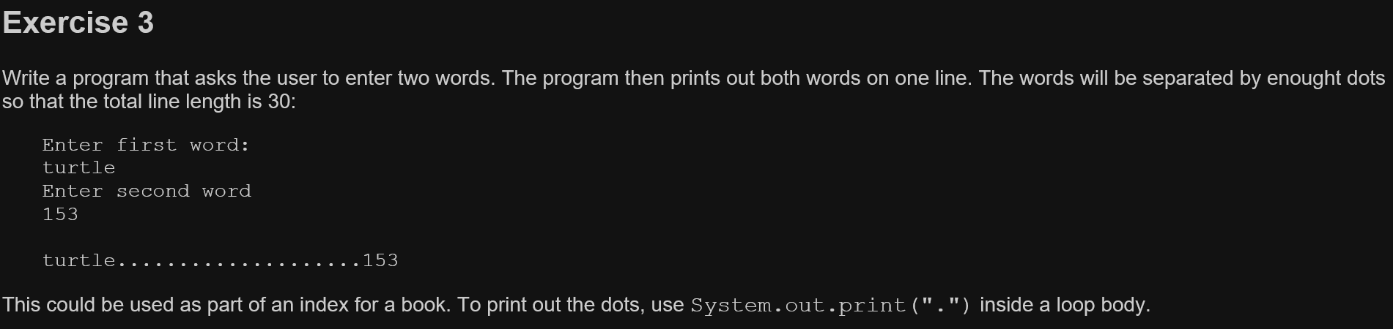

Slide 20
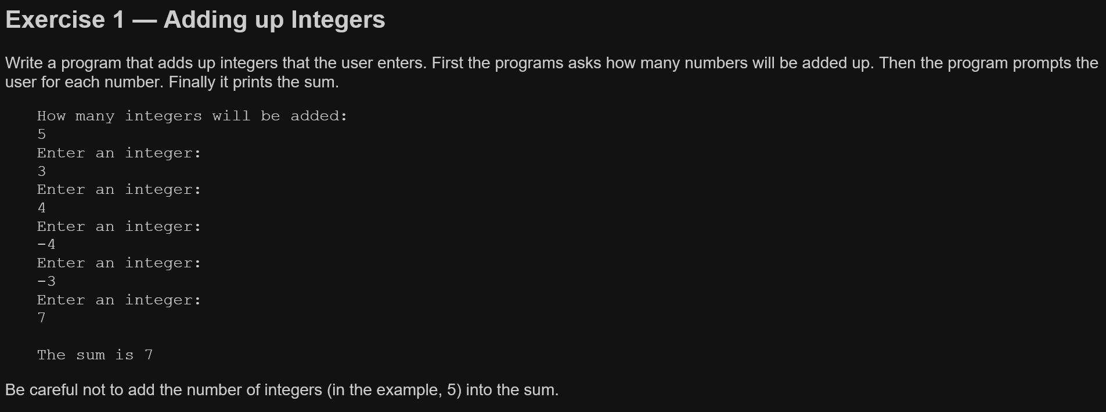
Part 2

Slide 21
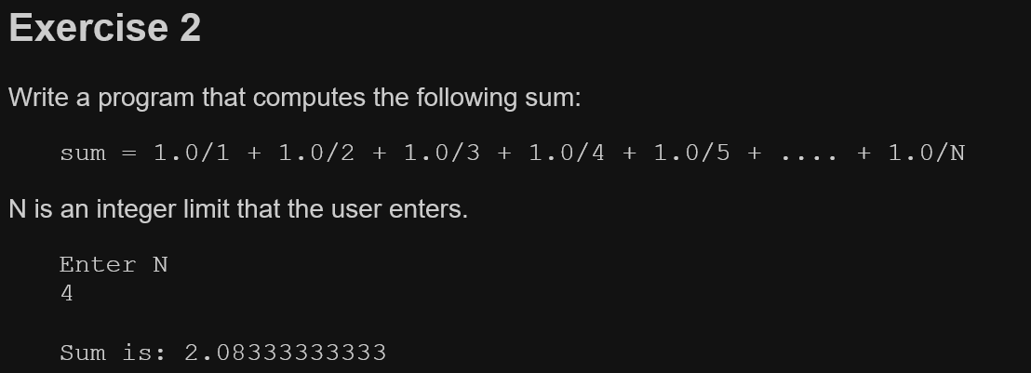

Slide 22
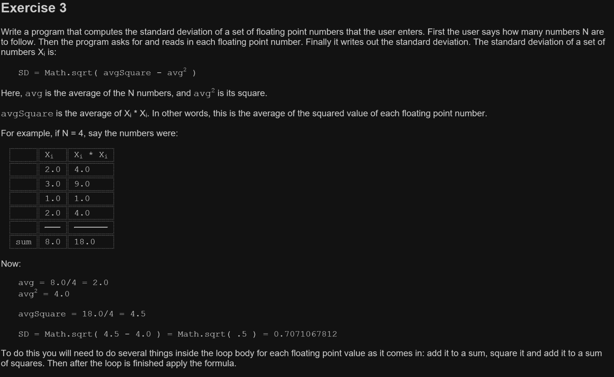

Slide 23
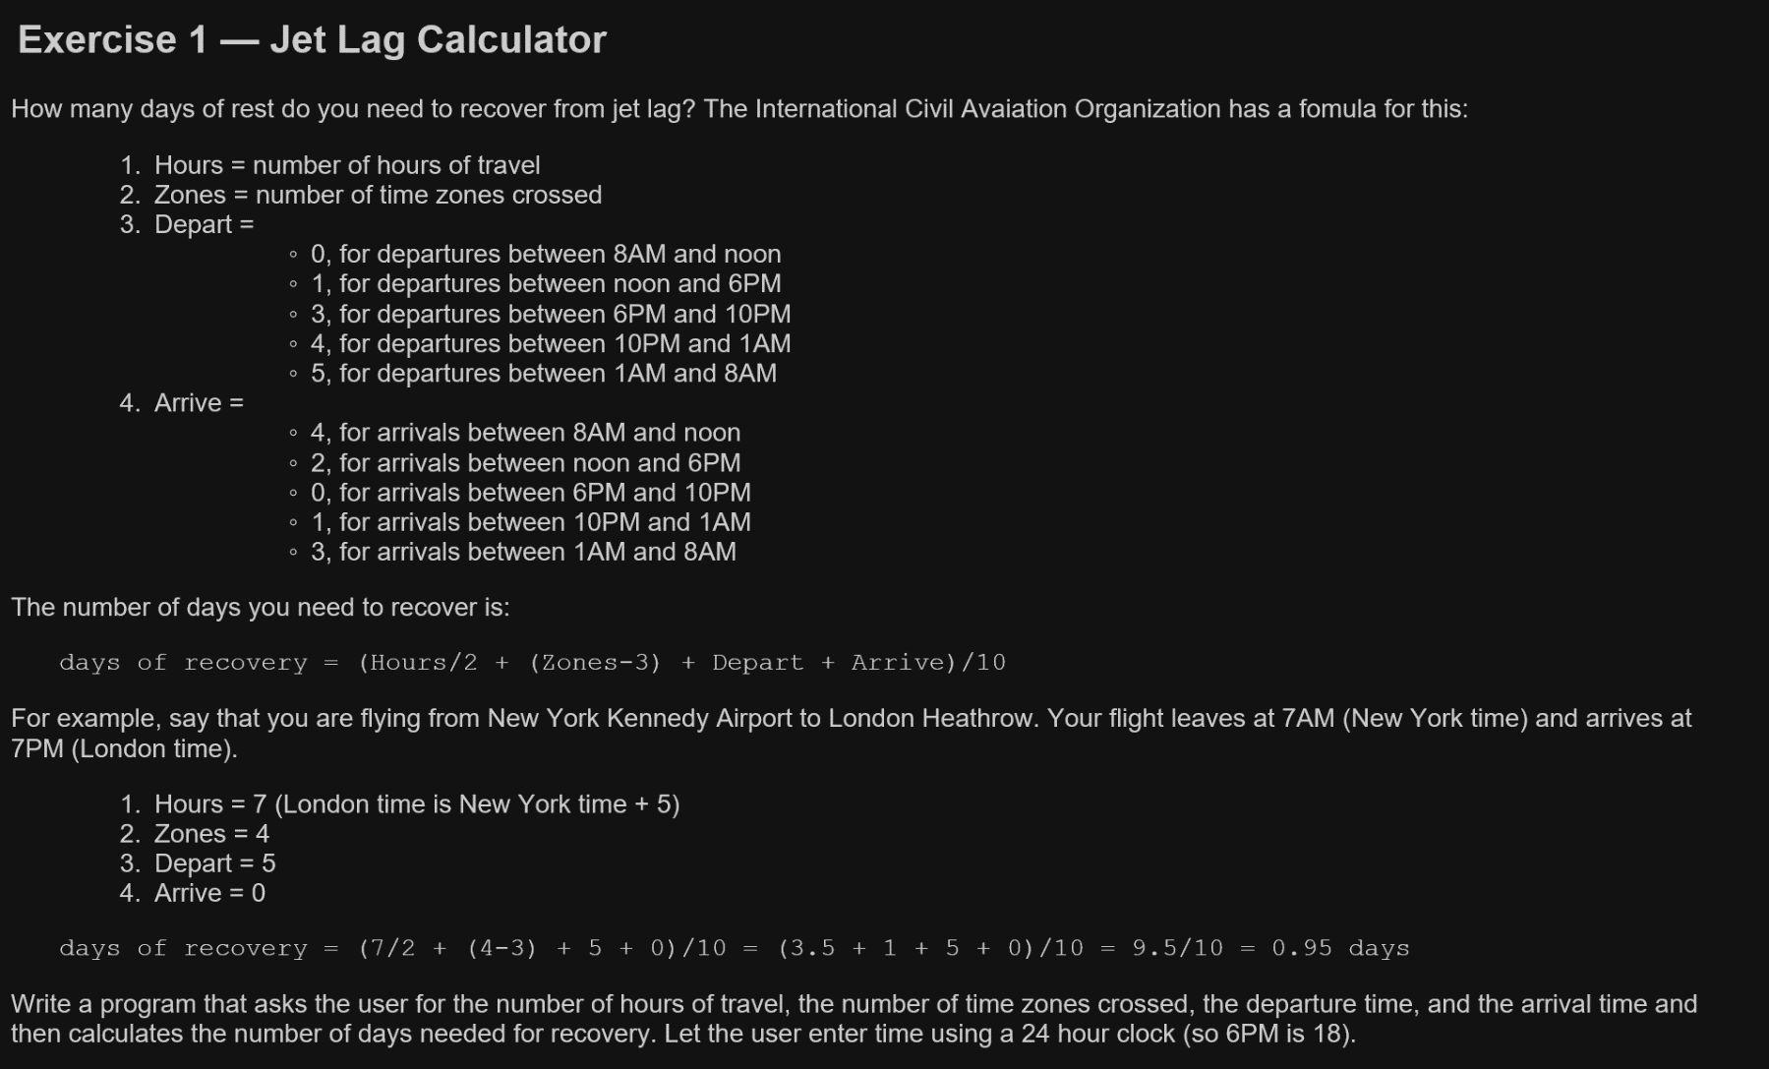
Part 3

Slide 24
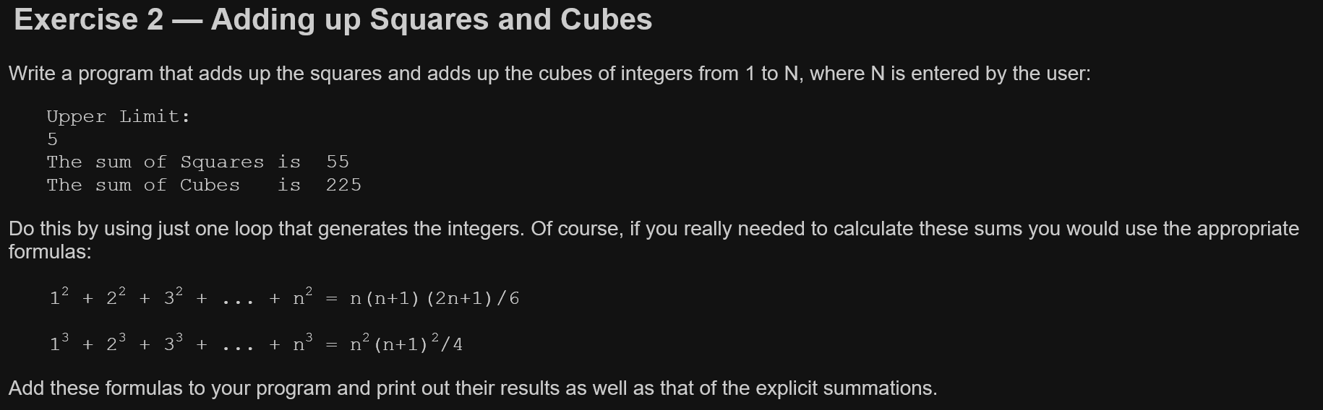

Slide 25
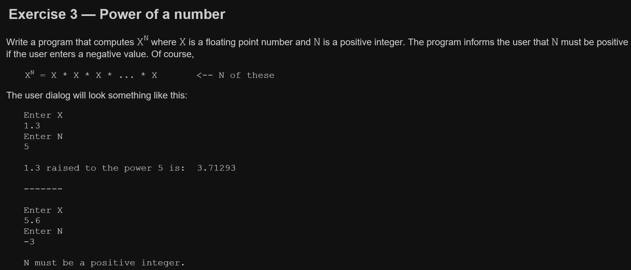

Slide 26
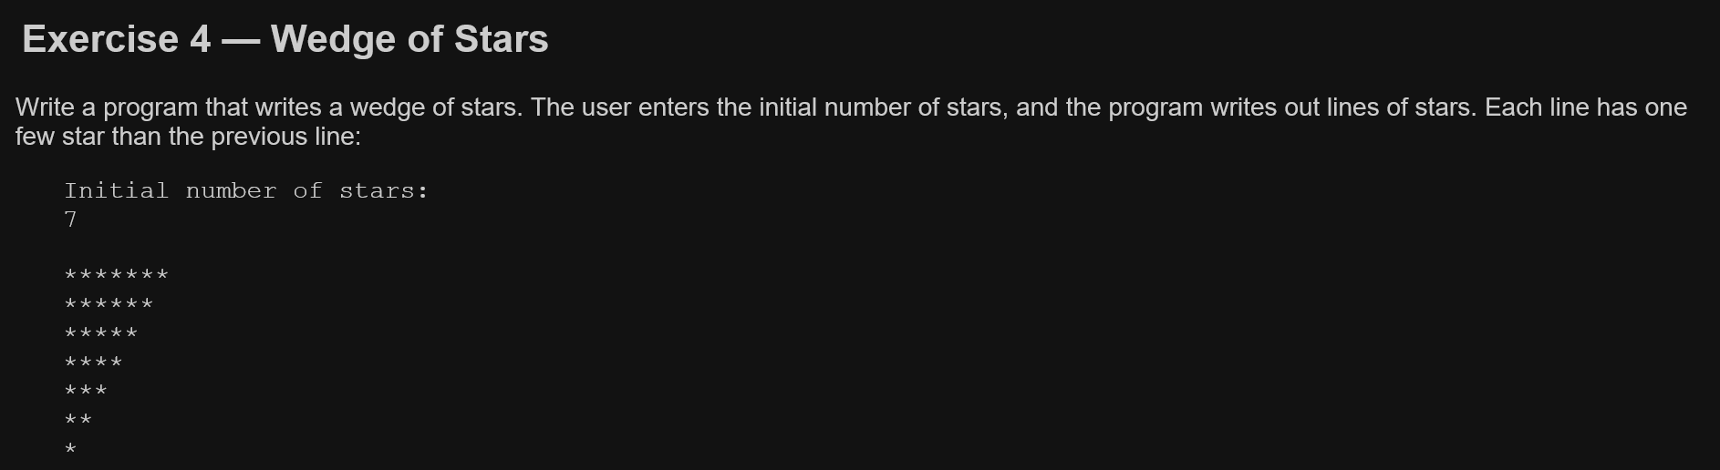

Slide 27
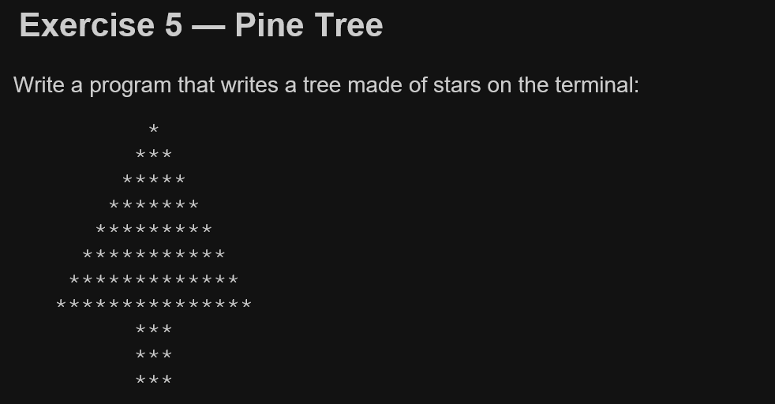

Slide 28
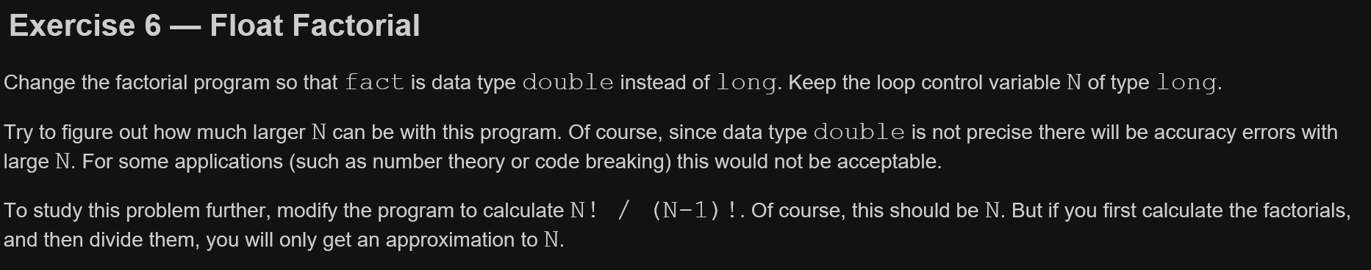

Slide 29
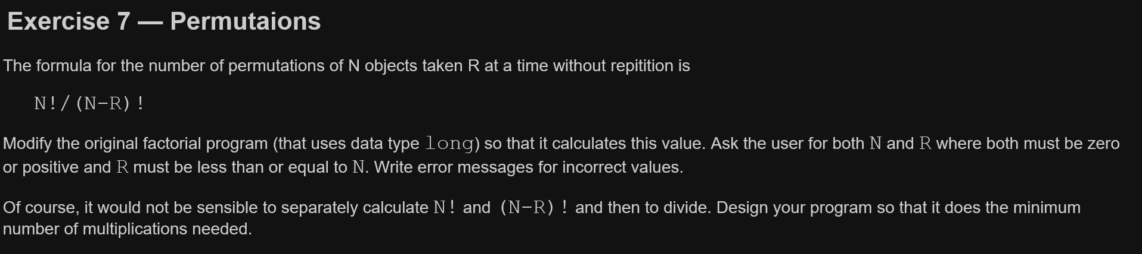

Slide 30
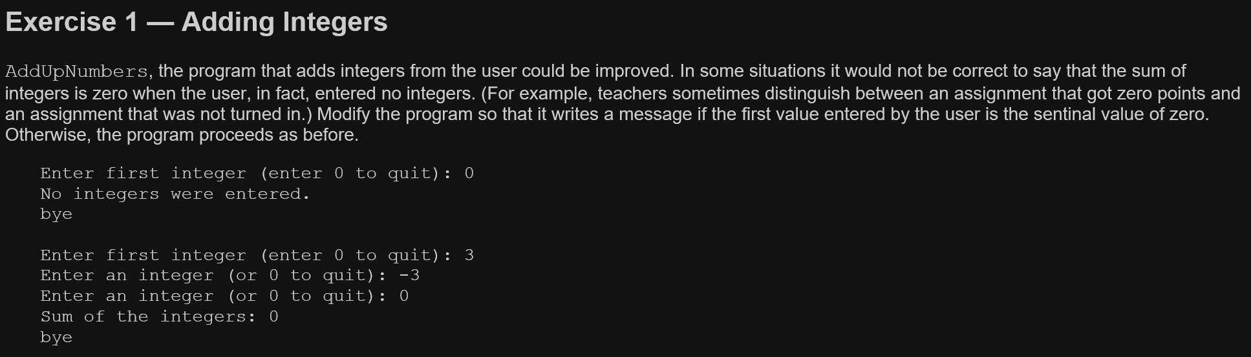
Part 4

Slide 31
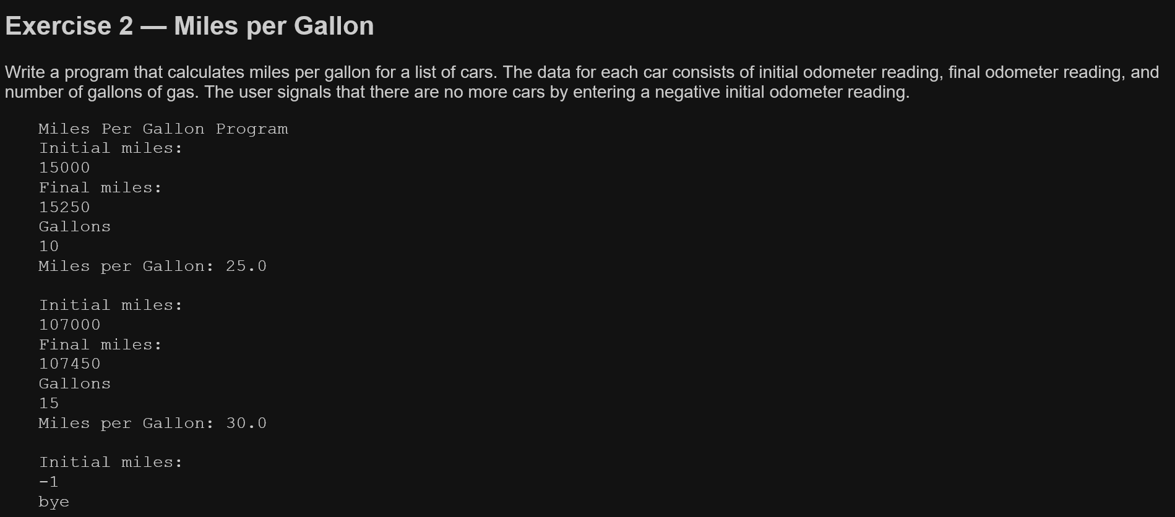

Slide 32
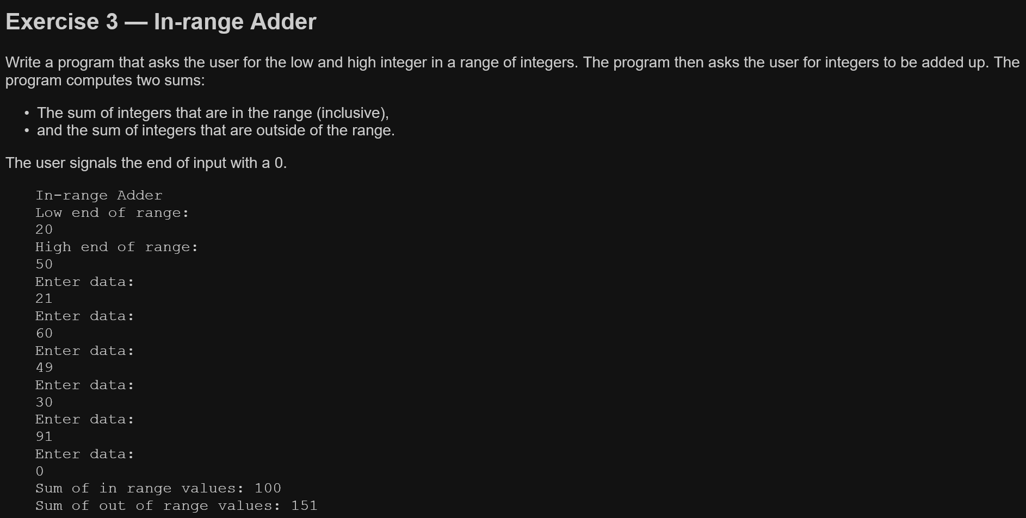

Slide 33
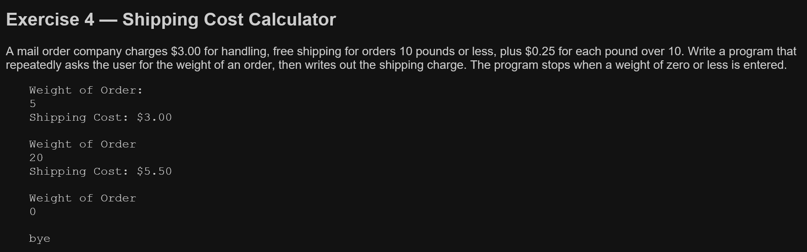

Slide 34
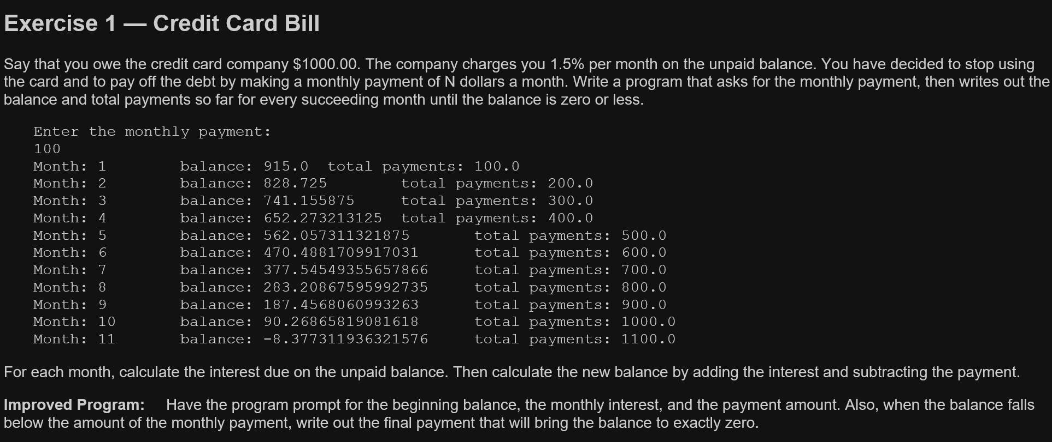
Part 5

Slide 35
